Slide 1
Network Attached Storage (NAS)
Module 3.2

Slide 2
NAS – Network Attached Storage
After completing this module, you will be able to:
Discuss the benefits of NAS based storage strategy
Describe the elements of NAS
Discuss connectivity options for NAS
Discuss NAS management considerations by environment
Identify the best environments for NAS solutions
Notes:
At one time, it was common for users within a given office or department to share directories from their own workstation. As this model continued to grow, data security and integrity became difficult to manage. File servers began to be used as a central repository for users’ data. Over time, as the storage and processing requirements of the file server continued to increase, the operational components of the file server itself became a performance and scalability bottleneck. PC operating systems added a significant amount of overhead, and commodity hardware could no longer meet the requirements for availability, scalability, reliability, and performance of a growing enterprise.
NAS devices were developed to address these challenges. NAS devices typically include:
High-performance, scalable hardware
Specialized operating systems and protocol interfaces designed specifically for file serving.
The first generations of NAS devices were typically very high-end and expensive. NAS technology has now moved into the small-medium business market. NAS has also evolved into being more than just a shared storage pool. By integrating intelligent storage features, simplified management, and data protection capabilities, it has become a valuable component to an enterprise’s information management strategy.

Slide 3
In this Module …
This module contains the following lessons:
What is NAS?
Managing a NAS Environment
NAS Application Examples

Slide 4
Lesson: What is NAS?
Upon completion of this lesson, you should be able to:
Define NAS and describe its key attributes
List the benefits of NAS
Describe NAS connectivity
Notes:
In this lesson, we will look at what NAS is, the challenges that it solves, and the elements in a NAS environment.

Slide 5

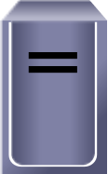


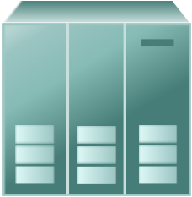
NAS Evolution
Portable Media
for File Sharing
Networked PCs
Networked File Sharing
Stand Alone PC
Network Attached Storage (NAS)
Notes:
In the past, floppy drives with capacities in mere KB’s were widely used to share data files. Over time the need for larger and larger capacity has emerged due to growing need for data to be shared across organizations. Removable storage media, such as flash drives, are capable of storing gigabytes (GB) of data have now complimented the traditional removable media drives.
Businesses not only need the capacity to handle huge data storage requirements, the need to share their data has made Network Attached Storage (NAS) an attractive option. NAS systems use external storage for server/hosts, adding flexibility to network storage. NAS works at the file level, rather than the block level. This enables widespread access to the data over the network, based upon the file system client loaded.

Slide 6
What is NAS?
NAS is shared storage on a network infrastructure.
Clients
NAS Head
Storage
Application
Server
Print
Server
NAS Device
Notes:
NAS is shared storage on a network infrastructure using a unique addressing schema. A NAS server is a storage device that consists of a high performance file server and attached to a LAN. It is a single-purpose machine serving as a dedicated, high-performance, high-speed communication gateway to file data.
Note: A NAS device is sometimes called an appliance or filer.
The NAS head (as illustrated) could be remote from its storage (gateway) or contained within the same cabinet as its storage—so that the storage is dedicated to NAS applications (integrated).

Slide 7
General Purpose Servers vs. NAS Devices
Applications
Print Drivers
File System
File System
Operating System
I/O
Network
Operating System
Network
Single Function Device
(NAS Server)
General Purpose Server
(NT or Unix Server)
Notes:
Unlike a general-purpose server, such as a Unix or NT server, a NAS server is a device optimized for file serving functions such as storing, retrieving, and serving files. A single function NAS device provides:
Real-time OS dedicated to file serving
Open standard protocols
Built-in native clustering for high availability

Slide 8
Why NAS?
Supports global information access
Improves efficiency
Provides flexibility
Centralizes storage
Simplifies management
Scalability
High availability – through native clustering
Provides security integration to environment (user authentication and authorization)
Notes:
The following are some benefits of NAS:
Supports global information access
Enables greater file sharing, even over a long distance
Supports many-to-one or one-to-many configurations
Can share data across platforms
Improves efficiency through specialized OS, optimized for file serving
Eliminates bottlenecks encountered when accessing files from central file server
Relieves general-purpose servers of many file management operations, improving performance of those servers
Flexibility - works with many types of clients on both UNIX and Microsoft Windows platforms using Industry standard protocols.
Centralizes storage – minimizes duplication on client workstations, reducing management complexity and improving data protection.
Simplifies management - leverages existing security infrastructure through standard network protocols. Single point of management for multiple systems for multiple data sets. Identifies data by file name and byte offsets, transfers file data or file meta-data.
Scalable - Due to its high performance, low latency design, enables NAS to scale well and depending upon utilization profiles, address many differing types of business applications.
High availability
Replication and recovery options
Can safely centralize large amounts of user data behind a single NAS device with redundant networking equipment to provide maximum connectivity options.
Clustering technology for failover in the event of filer failure
Handles security, user authentication, and file locking in conjunction with industry standard security schemas.

Slide 9
Customer Demands for NAS Have Changed
T H E P A S T
T O D A Y
Outside the
Data Center
Critical Business
Applications
(Databases)
Islands of
Information
Integrated
Infrastructure
Tools and
Scripts
Enterprise
Management
Notes:
Initial demands for NAS were outside the data center. As the technology matured, the criteria have changed:
Instead of localized use, it is more enterprise focused
Desire for cost effective and simple implementation of departmental databases
Need to distribute, consolidate, and migrate data
Decreases in IT budgets
New protocol developments, iSCSI, FCIP, iFCP
Integration with newly introduced Microsoft technologies
Increase in opportunities for consolidation
NAS is now a powerful, easy to manage, networked information repository. Administrators now look to NAS to provide a storage repository for small database applications, act as a transitional storage pool for backups, and many other tasks. Some organizations add enterprise NAS services to their SANs and leverage centralized storage.

Slide 10
NAS Device Components
NAS Device
Network Interface
NFS
CIFS
IP Network
NAS Device OS
Storage Interface
SCSI, FC, or ATA
Notes:
A NAS device is made up of the following components:
Network Interface via one or more Network Interface Cards (NICs)
Examples: Gigabit Ethernet (1000 Mb/s), Fast Ethernet (10Mb/s), ATM, and FDDI.
Network File Systems (NFS) and Common Internet File Systems (CIFS) protocols
Proprietary, optimized Windows, UNIX, or LINUX based OS. Examples:
DART - Data Access in Real Time (EMC)
Data ONTAP (Network Appliance)
Industry standard storage protocols to connect to and manage physical disk storage resources.
Examples: Serial ATA (SATA), SCSI, or Fibre Channel

Slide 11
NAS File Services Protocols: NFS and CIFS
Unix
NAS Device
NFS
Network Interface
NFS
CIFS
IP Network
NAS Device OS
CIFS
Storage Interface
Windows
SCSI, FC, or ATA
Notes:
Most NAS devices support multi-protocol file services to handle file I/O requests to the remote file system. The more common protocols for file sharing are:
Network File Systems (NFS) - developed by Sun and closely aligned with UNIX-based operating systems
Common Internet File Systems (CIFS) – developed by Microsoft and closely aligned with Windows-based operating systems
These file system protocols allow users to share file data across different operating environments as well as provide a means for users to transparently migrate from one operating system to another.
File system is mounted remotely using NFS or CIFS protocol
Application I/O requests transparently transmit data to the remote file system by the NFS/CIFS protocol. This is also known as redirection.
Utilizes mature data transport (TCP/IP) and media access protocols
NAS device assumes responsibility for organizing block level data (R/W) on disk and managing cache
Note: In NAS, I/O from the client is handled by network file access protocols (NFS/CIFS) at the file level, rather than at the block level. Meaning that the client does not need to be aware of physical disk volumes or disk characteristics. Unlike block I/O, there is no awareness of a disk volume, LBA, or disk sector in a file I/O request. The NAS appliance operating system is responsible for keeping track of where files are located on the physical disk subsystem. The NAS device OS issues block I/O requests to the physical disks to fulfill the file I/O read and write requests it receives from clients.

Slide 12
Network File System (NFS)
Client/server application
Uses RPC mechanisms over TCP protocol
Mount points grant access to remote hierarchical file structures for local file system structures
Access to the mount can be controlled by permissions
Notes:
NFS is a client/server application that enables a computer user view and optionally store and update files on a remote computer as though they were on the user's own computer. It uses Remote Procedure Calls (RPC) to communicate between computers.
The user's system requires an NFS client to connect to the NFS server. Since the NFS server and client use TCP/IP to transfer files, TCP/IP must be installed on both systems.
Using NFS, the user or system administrator can mount all or a portion of a file system (which is a portion of the hierarchical tree in any file directory and subdirectory). The portion of the file system that is mounted (designated as accessible) can be controlled using permissions (e.g., read-only or read-write).

Slide 13
Common Internet File System (CIFS)
Public version of the Server Message Block (SMB) protocol
Client applications access files on a computer running server applications that accept the SMB protocol
Better control of files than FTP
Potentially better access than Web browsers and HTTP
Notes:
CIFS is client/server application protocol, which enables clients programs make requests for files and services on remote computers on the Internet. CIFS is a public (or open) variation on Microsoft’s Server Message Block (SMB) protocol. SMB is widely used on LANs. Like SMB, CIFS runs at a higher level than, and uses the Internet's TCP/IP protocol. CIFS is viewed as a complement to the existing Internet application protocols such as the File Transfer Protocol (FTP) and the HyperText Transfer Protocol (HTTP).
The CIFS protocol allows the client to:
Get access to files that are local to the server and read and write to them
Share files with other clients using special locks
Restore connections automatically in case of network failure
Use Unicode file names
In general, CIFS gives the client user better control of files than FTP. It provides a potentially more direct interface to server programs than currently available through a Web browser and the HTTP protocol.

Slide 14
NAS Connectivity: A Closer Look
Application
NFS
Presentation
FTP, Telnet
SMTP, SNMP
XDR
Session
RPC
Transport
TCP, UDP
Network
IP
Data Link
ARP / RARP
Physical
Not Defined
OSI Seven-Layer Module
Internet Protocol Suite
Notes:
While CIFS and NFS are file system protocols, it is important to understand how the network transport protocols of IP, TCP, and FTP fit into the picture.
OSI model (developed by the ISO standards body) - defines the specific layers that are responsible for communication tasks.
Internet Protocol Suite – defines a group of open-system (non-proprietary) protocols that communicate across interconnected networks (LAN/WAN). This suite includes both low layer protocols (e.g., IP and TCP) as well as common applications such as electronic mail, terminal emulation, and file transfer (FTP).
IP is a network-layer protocol that contains addressing information and some control information, enabling packets to be routed.
In NAS, the back-end connects to its storage most often using Fibre Channel interconnectivity and the front-end/client connectivity most often via the TCP/IP protocol. If any client wants to access a file from NAS system, it requests the file directly. The NAS system then converts this request in block level access and retrieves data from storage and presents data to client as a complete file.

Slide 15
I/O Example
Application
Storage Interface
Operating System
Storage Protocol
Block I/O to storage device
I/O Redirect
NAS Operating System
NFS / CIFS
NFS / CIFS
TCP/IP Stack
TCP/IP Stack
Network Interface
Network Interface
Client
IP Network
NAS Device
Notes:
NFS and CIFS protocols handle file I/O requests to the remote file system, which is managed by the NAS device.
I/O requests are packaged by the requestor into TCP/IP and forwarded through the network stack, transported across the network, and received by the NAS.
The NAS converts the protocol request into an appropriate physical storage request (block I/O), and then performs the operation against the physical storage pool.
The data returned from the physical storage pool is then processed by the NAS and repackaged into an appropriate file protocol response.
This response is packaged into TCP/IP again and forwarded through the network to the client.
This example shows an operation being directed to the remote NAS device and how the different protocols and software layers play a part in moving the request and response between the client and NAS.

Slide 16
UNIX and Windows Information Sharing
NFS Traffic
FTP
CIFS Traffic
Protocol Layer
Common File System (CFS)
Multi-protocol support layer
OS
I/O layer
Notes:
Due to the structure of the specialized operating system on NAS devices, multiple protocol stacks can be simultaneously supported, thereby allowing disparate systems access to the storage simultaneously.

Slide 17
NAS Physical Elements
Data movers/filers
Management interface
  Configure network interfaces
  Create, mount, or export file system
  Install, configure and manage all data movers/filers
  Can be accessed locally or remotely
Connectivity
  NAS head to storage
  NAS head to network
Storage
Notes:
NAS devices are comprised of similar components:
Data Movers/Filers - Essentially high-end file servers which move data between the network and the storage.
Contain memory, ports for network (Ethernet) and storage connectivity, and other common server components.
Present file systems to desktop clients and application servers as a shared storage device/file system on an IP network.
Uses a specialized OS
Management interface - A controlling device for management and configuration
Connectivity - The NAS head is connected to the back-end Fibre Channel HBA’s. NAS HBA’s can be connected directly to the storage device or can use Fabric switches.
Storage - High performance, dedicated storage configured to provide high level of data availability and data protection using combination of RAID configurations. The storage can be:
Integrated (dedicated, directly attached to NAS devices)
Gateway (shared, directly or fabric attached devices)

Slide 18

Integrated vs. Gateway NAS
Integrated NAS
IP Network
NAS Head
NAS Gateway
FC Fabric
IP Network
NAS Head
Notes:
There are two types of NAS devices available today:
Integrated - combines the NAS controller and the dedicated storage into a single packaged solution.
Gateway – the NAS controller is separate and configured to use pre-existing shared external storage such as that found on a SAN. The storage can be connected via FC.

Slide 19
Integrated NAS System
Integrated NAS System
IP Network
Direct Attach
NAS Head
Storage
Notes:
In this type of configuration, back-end storage is directly connected to the NAS Head. It is dedicated to one NAS head, not shared with any other servers. Storage is utilized to maximum capacity by the NAS head to get maximum throughput from such a configuration.
The benefits of integrated NAS include:
Pooled / centralized storage
Easier administration
Protected mission critical data with backup features (disk & tape)
Higher availability
Heterogeneous file sharing
No need to do storage management
Offloads SAN cycles
Increased performance throughput (service level) to end users
Scalable
Lower Total Cost of Ownership

Slide 20
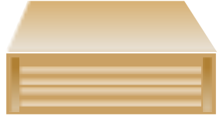

Gateway NAS System
Clients
IP Network
Application Servers
IP Network
FC Switch
NAS Gateway
Storage
Notes:
In this configuration, back-end storage is shared between different types of application servers (SAN environment) and NAS heads. Different types of back-end storage can be attached to one NAS head. The NAS head boots from one storage and users pool storage for clients from other storage. This is a typical SAN setup, where the NAS head works as gateway to SAN environment.
NAS Gateways provide the same benefits and characteristics of NAS:
Connects to IP networks
Performs as a file server
Heterogeneous file sharing
Data protection
Diagnostic capabilities
Clustering and failover features
NAS Gateway gives you the combined benefits of NAS and SAN:
SAN scalability and performance
NAS flexibility and ease of use
Increases the reach of SAN infrastructure
Extends beyond topology limitations of FC
Provides IP device access to SAN storage
Leverages the value of SAN investment
Reduces access costs.
Allows access to underutilized SAN storage.
Enables heterogeneous file serving
Note: Some NAS Gateway designs offer multiple connectivity options: FC switches, hubs, directors, RAID controllers and disk arrays.

Slide 21
Lesson Summary
A NAS server is an appliance optimized for file serving functions.
Generally it has a specialized operating system
NAS supports multiple protocols
NAS can be implemented as an integrated system or as a gateway

Slide 22
Lesson: Managing in a NAS Environment
Upon completion of this lesson, you will be able to:
Describe the issues involved in managing a NAS environment
Differentiate between the issues related to managing an integrated system vs. a gateway system
Notes:
Now that you have learned about the components in a NAS environment and ways that NAS can be implemented, we will look at the issues involved in managing a NAS environment.

Slide 23
About Managing NAS Devices
Most ship with vendor management software
Have unique management issues
Require preliminary analysis
Need additional complementary software
Notes:
Most NAS devices ship with vendor supplied management software, which typically provides a means to configure a NAS device. Select devices even provide basic device monitoring and performance capabilities. NAS devices have several unique management issues, such as: device availability, backup and recovery in addition to traditional storage management issues, such as: resource management, space management, capacity, and performance analysis. Monitoring CPU utilization, memory utilization along with IP traffic are also factors. All are essential to ensure service levels are met.
Preliminary analysis - assess the environment.
Inventory of all implemented NAS devices (capacity, utilization, performance, location, etc.).
Understand the backup/recovery strategies.
Identify what tools are currently managing the NAS device and whether they meet your needs.
Understand what needs to be accomplished.
Once the inventory of the NAS device(s) is complete, the following conclusions should be reached:
The number of NAS devices already installed in the organization.
The physical configuration of the NAS device (i.e., number of CPUs, amount of memory, IP connections, etc.).
The logical or resource management aspects of the device (mapping of the logical volumes to the physical spindles, mapping of the file systems to the logical volumes and perhaps the allocation attributes of the file systems).
The backup/recovery methodologies.

Slide 24
NAS Management Concerns
Performance
Discovery
Space Management
Backup/Recovery
Asset Management
Notes:
The following management concerns need to be considered when using NAS:
Performance - includes physical device performance (CPU utilization, memory utilization, number of I/O requests received, cache performance, etc.) as well as CIFS/NFS performance. Management software should not only collect this data, but also filter it so intelligent events can be initiated when thresholds are breached.
Discovery - the ability to discover a NAS device(s) –along with its hardware configuration and logical storage attributes—as they change, without manual entry.
Space Management - administrators need to know who is using it, what they are using, and how much of it.
Backup/Recovery - Backup and recovery for NAS is similar to other file servers.
Logical backups at the file and file system level need to be considered along with more database-centric backup and recovery solutions involving data associated with a relational database management system (RDBMS).
Many tools are available that cover the full range of backup and recovery options.
Asset Management -There are two aspects to asset management:
Physical attributes of a NAS device, and its associated configuration
Logical or data aspects.
Both need to be inventoried and, in most cases, have some level of cost recovery.
The ever-changing capacity information of a NAS device needs to be collected in order to correlate that data to utilization. This can be either at the user or application level, with the data being fed into the fixed asset repository to create cost recovery reports.

Slide 25
Managing NAS Environments
Managing an Integrated System
  Both NAS component and the storage array are managed via NAS management software
Managing a Gateway System
  NAS component managed via NAS management software
  Storage array managed via array management software
Notes:
Managing an Integrated System
Since the storage array is dedicated to the NAS functionality, the NAS management software is responsible for the managing both the NAS components and the backend storage array.
Managing a Gateway System
Gateway NAS Systems use shared storage, which means that traditional SAN hosts can also utilize the same array. Therefore both the NAS hardware and the array are individually managed by their own specialized management software:
The NAS component is managed via specialized NAS management software
The storage array is managed via its native array management software
Supports standard host connectivity where integrated does not (enabling the array to be multipurpose).

Slide 26
Lesson Summary
Key points covered in this lesson:
NAS management involves several areas: performance, discovery, space management, backup/recovery, and asset management
The management is handled differently in integrated and gateway NAS environments

Slide 27
Lesson: NAS Examples
Upon completion of this lesson, you will be able to:
Discuss environments that would benefit from a NAS solution including:
  NAS solution for HTTP file server
  NAS consolidation
  NAS solution for Gateway NAS system

Slide 28
NAS HTTP File Server Scenario
Current Environment
Internal Users
Business Clients
Surfers, Shoppers
LANs / WANs
Web
Database
Transaction
Mission
Critical
Servers
SAN
(Fibre Channel)
Notes:
Shown is a typical server centric business scenario. With the advent of server based operating systems that are relatively easy to deploy, there has been a huge proliferation of “server farms” within business practices. However this does not always allow the businesses to follow tried and tested enterprise lessons learned. Some of these lessons are:
Dedicate the right resources where they are needed
Plan for correct resource utilization and prevent causing contention by mixing/using resources for purposes that they were not intended for.
Some examples of this in the server centric world, is the fact that general purpose servers are deployed to perform specialized tasks. Servers that house mission critical databases are also used as print job targets, or home directory locations and could even be used for general web serving services.
This promotes bottlenecks and access contention throughout the whole infrastructure

Slide 29


NAS HTTP File Server Example
Solution
Internal Users
Business Clients
Surfers, Shoppers
LANs / WANs
HTTP
Server
NAS Head
SAN
(Fibre Channel)
Database transaction
mission critical servers
Notes:
By deploying specialized solutions within the infrastructure, general purpose servers are allowed to become more specialized in their deployment and utilization. NAS deployments allow specialized servers to have easily deployed infrastructures to access their dedicated data. NAS also allows for certain types of I/O profiles to be separated, file level and block level, to provide businesses with better decision criteria for storage and access choice.
Benefits:
Offloads SAN cycles
Increases performance throughput (service level) to end users
Minimizes investment in additional servers
Provides storage pooling
Provides heterogeneous file servings
Uses existing infrastructure, tools, and processes
Isolates web clients away from mission critical data

Slide 30
NAS Server Consolidation Scenario
Current Environment
UNIX
NT
W2K
Internet/Intranet
UNIX
Windows
General purpose OS serving files via
FTP, CIFS, NFS, HTTP. . .
Notes:
In many companies the need for two differing environments maintains the separation of two technologies using the same infrastructure for the same purpose, but indifferent ways. Access to networked files for UNIX (NFS) and Microsoft (CIFS) are traditionally housed on separate servers infrastructures.

Slide 31
NAS Server Consolidation Example
Solution
NAS
File
Server
Internet/Intranet
UNIX
Windows
General purpose OS serving files via
FTP, CIFS, NFS, HTTP. . .
Notes:
However by implementation of NAS these same file structures can be housed together, while still maintaining their integrity. Within NAS deployments the same file system can be accessed by the same user via different technologies, either NFS or CIFS, and still maintain the integrity of the data and security structures, as long as the applications used for both methodologies understand the data structures presented.
Benefits of this solution:
Provides continuous availability to files
Heterogeneous file sharing
Reduces cost for additional OS dependent servers
Adds storage capacity non-disruptively
Consolidates storage management
Lowers Total Cost of Ownership

Slide 32
Gateway NAS Scenario
Why purchase additional Integrated NAS Storage when you have SAN Storage?
Capitalize on your storage investment and purchase NAS functionality without the cost of additional NAS Storage.

Slide 33
Gateway NAS Example
Multipurpose
Servers
NT
UNIX
IP Network
FC Switch
NAS Gateway
Notes:
Benefits:
Provides continuous availability to files
Heterogeneous file sharing
Reduces cost for additional OS dependent servers
Adds storage capacity non-disruptively
Consolidates storage management
Lowers Total Cost of Ownership
Note: FC has distance limitations and is costly to deploy when compared to cost of departmental or workgroup class servers.

Slide 34
Example Summary
Key points covered in this lesson:
HTTP example
Consolidation example
Gateway example

Slide 35
NAS Challenges
Speed
  Network latency and congestion
  Protocol stack inefficiency
  Application response requirements
Reliability
Connectivity
Scalability
Notes:
Speed
Network latency and congestion
Protocol stack inefficiency
encapsulation, possessor overhead, and relatively small payload
Application response requirements
Reliability
Due to the large geographical coverage of enterprise networks there are inherent possibilities for network failures, but with redundancy planning these issues can be minimized.
Centralized storage silos may become single points of failure without remote mirroring or backup facilities.
Connectivity
Without newly emerging technologies, iSCSI, FCIP & iFCP, many applications required block level access therefore excluding NAS as a solution for businesses
Scalability
Although NAS devices can scale to terabytes of storage capacity, once the capacity is exhausted the only way to expand is to add additional devices. This can cause additional problems when data center real estate is at a premium
Once a NAS device is fully populated, including external storage enclosures, the only remaining scaling option is to buy another system. When data center real estate is at a premium this can be seen as a major limitation.

Slide 36
Module Summary
Key points covered in this module:
A NAS server is a specialized appliance optimized for file serving functions.
Overview of physical and logical elements of NAS
Connectivity options for NAS
Common NAS topologies
NAS connectivity devices
NAS management considerations by environment
Best environments for NAS solutions

Slide 37
Check Your Knowledge
✓
What are the differences between a General Purpose Server and a NAS Device?
What are the components of a NAS device?
What protocol is used to connect to and manage physical disk storage resources in a NAS system?
Give an example of a file sharing protocol.
What is the difference between an integrated NAS system and a gateway NAS system?

Slide 38
Apply Your Knowledge…
Upon completion of this topic, you will be able to:
Describe EMC’s product implementation of a NAS solution

Slide 39
NAS equipment building blocks
NAS device consists of:
  Network interface device (EMC called Data Mover)
  Storage interface device (EMC called Data Mover)
  Management interface device (EMC called a Control Station)
  Storage connectivity mechanism
    Direct connect
    Gateway connect
Storage device
Storage Interface Device
Management Interface Device
CLARiiON
Storage Processor
Navisphere Manager
Symmetrix
FA (Fibre Channel Adapter)
Service Processor

Slide 40
What is a Data Mover ?
A Data Mover is a specialized hardware platform with :
Dual Intel Processors
PCI or PCI-X based
High memory capacity
Multi-port Network cards
Fibre Channel connectivity to storage arrays
No internal storage devices
Operates on a highly specialized Operating System, DART (Data Access in Real Time).
Notes:
Each Data Mover (DM) is an independent, autonomous file server that transfers requested files to clients and writes client changes to files over an existing network infrastructure and back end storage infrastructure.
There can be multiple DMs (up to 8 in the NSX frame), which are managed as a single entity by the Control Station.
A DM connects to a network infrastructure via FastEthernet or GigabitEthernet and has multiple ports for this connectivity.
There is no remote login capability on the DM, nor do they run any binaries (very secure). The only interface for management and configuration is the Control Station.
The EMC NAS system also allows for active (primary) Data Movers to be protected by another Data Mover, of the same configuration, in the same frame as a standby. In the event of a primary failure the Control Station will facilitate a failover to the standby until the primary can be repaired. This promotes continued availability of data in the event of a failure.

Slide 41
What does a Data Mover Do?
Once a Data Mover has been presented storage from a storage array, the storage is divided up using an Automated Volume Management feature of DART to provide volumes for file system creation.
The Data Mover supports both NFS and CIFS protocols simultaneously and is able to server out data to either protocol individually or data to both protocols at the same time.
In order to share data out to differing clients simultaneously the Data Mover integrates into the security structures of both environments seamlessly
Notes:
Once a Data Mover has been presented storage from a storage array, the storage is divided up using an Automated Volume Management feature of DART to provide volumes for file system creation. Once these file systems have been created, mounted and exported or shared (depending on the protocol used)--via the Control Station--a client, configured with the correct protocol on a network infrastructure, can start to use the storage for data location.

Slide 42
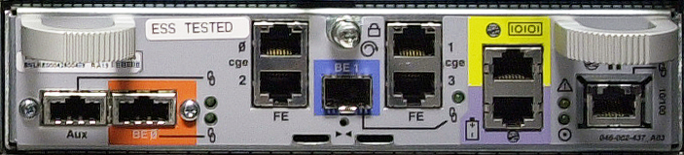
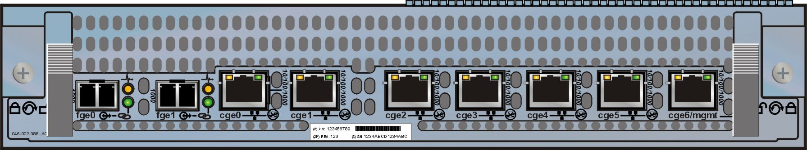
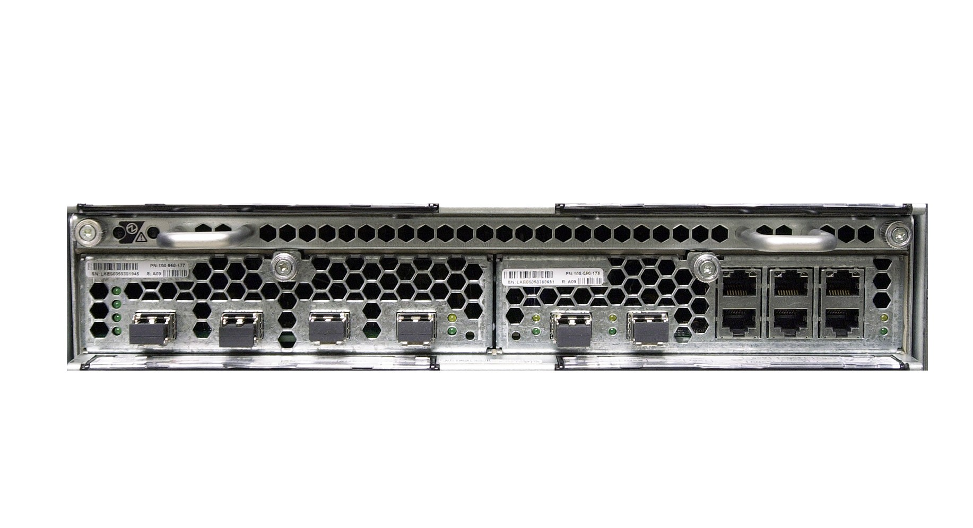
Data Mover Summary
NS500 Data Mover
NS700 Data Mover
NSX Blade
Fibre I/O module GbE I/O module
Notes:
These are the most common types of Data Mover used in EMC NAS equipment.

Slide 43
What is a Control Station ?
A Control Station is a dedicated management, Intel processor based computer running EMC Linux to provide:
Specialized software installation and upgrade portal
Management of high availability features
  Fault monitoring
  Fault recovery
  Fault Reporting (CallHome)
Management of Data Mover configuration and storage for the system configuration database
Remote diagnosis and repair
Notes:
The Control Station is a dedicated management Intel processor-based computer that monitors and sends commands to the blades. The private network connects the two Control Stations (always shipped on NSX systems) to the blades through the system management switch modules.
Some EMC NAS systems support two Control Stations for redundancy and continued management of the system. However if a Control Station fails without a standby system, all operational Data Movers will continue to function without an impact to their clients, only configuration and management tasks will be affected until the Control Station is repaired
Like previous versions it provides software installation and upgrade services, and high-availability features such as fault monitoring, fault recovery, fault reporting (CallHome), and remote diagnosing. Two Control Stations can be connected to a public or private network for remote administration. Each Control Station has a serial port that connects to an external modem so that the Control Station can call home to EMC or a service provider if a problem should arise.

Slide 44
Control Station System Management – Command Line
The Control Station provides both management interfaces to NAS administrators:
Command line can be accessed on the Control Station via:
  An ssh interface tool (e.g. PuTTy)
  Telnet (not enabled by default for security)
Its primary function is for the scripting of common repetitive tasks that may run on a predetermined schedule to ease administrative burden
It has approximately 80 UNIX command-like commands:
  nas_ - Generally for the configuration and management of global resources
  server_ - Generally for the configuration and management of Data Mover specific resources
  fs_ - Generally for special file system operations
Notes:
The most powerful interface is the Command Line Interface. Its primary function is to perform one-off tasks, or to create scripts to perform multiple repetitive tasks in one operation. The preferred access method to the Control Station for the command line is the ssh shell, as enabling Telnet increases the risk of unauthorized access and it is not enabled by default.
The forms of commands within the Celerra environment are: nas_ , server_ and fs_ .

Slide 45
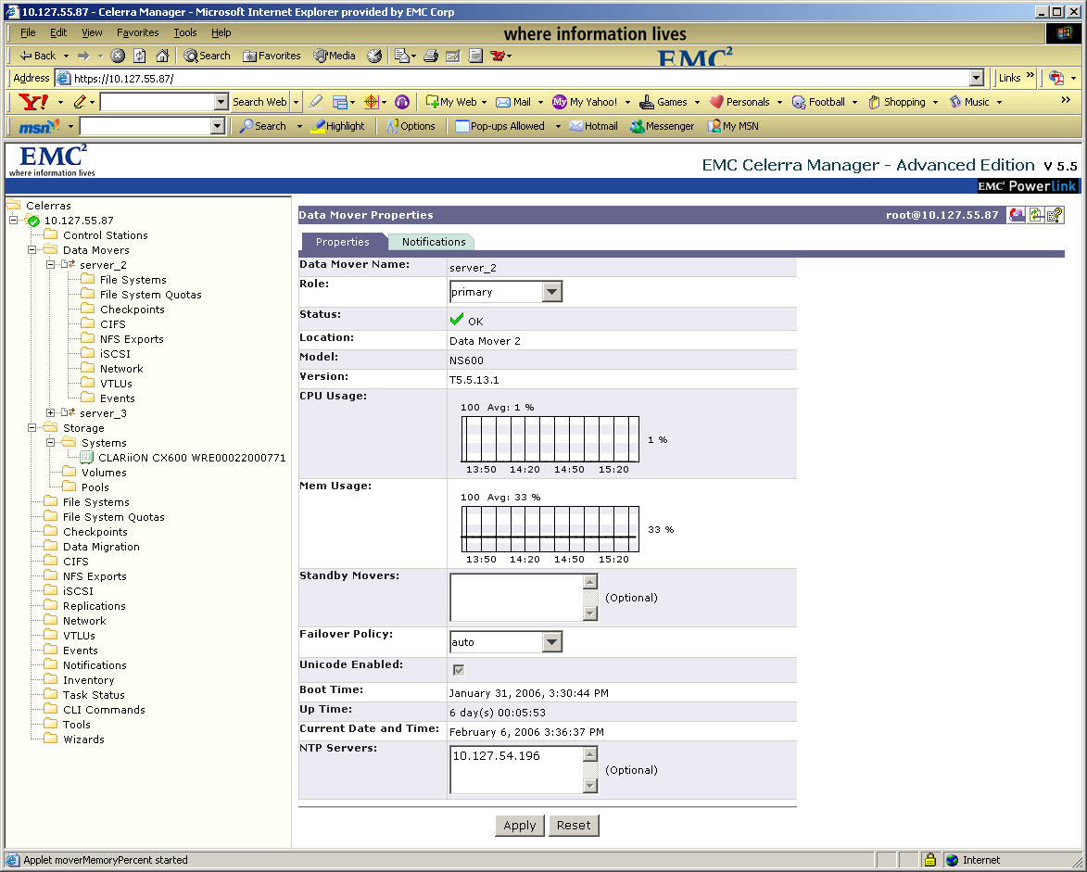
Control Station System Management – GUI Management
Notes:
The other Celerra specific interface is the GUI access methodology of the Celerra Manager. This is built into the Linux operating system that runs on the Control Station and is launched through a web browser session. There are two version of this interface, Basic and Advanced, that are installed alone with the EMC Linux on to the Control Station. The options are enabled with the purchase of additional licenses to access differing levels of feature support.

Slide 46
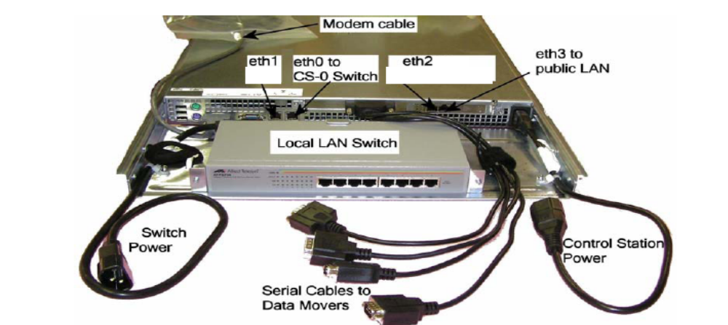
Celerra NS Family – Control Station Hardware
Notes:
Here is an example of Celerra NS Family Control Station hardware.

Slide 47
Joining the Building Blocks - Integrated
Data Mover
IP Network
Internal Network
Switch
Control Station
Serial cable connect
Internal network connect
Fibre Channel storage connect
Notes:
For an Integrated configuration the system is assigned to dedicated NAS storage. This means that there are no other SAN hosts connected to the storage and therefore the whole array is dedicated solely to NAS provisioning.
In the case of EMC NAS the Control Station is a separate system running an EMC flavor of Linux. This is connected to the Data Movers (client network data provider) via both an internal Ethernet and serial interface connection. The Data Mover has two internal network connections for redundancy
Each Data Mover is directly, dual connected to the Storage array via Fibre Channel connections in the Integrated configuration.
Once the storage array has been connected and the specialized operating system is loaded the storage array physical disks are partitioned via commands from the Control Station to create the system volumes and the data volumes.
Once the specialized operating system (DART) has been loaded the Data Movers can be connected to the client network in preparation for data sharing and the Control Station for remote management.
The storage array in an integrated NAS solution is an EMC CLARiiON.

Slide 48
Joining the building blocks - Gateway
Data Mover
Fibre Channel
Switch
NAS
NAS
NAS
NAS
NAS
NAS
IP Network
Internal Network
Switch
SAN
SAN
SAN
SAN
SAN
SAN
Control Station
SAN Host(s)
Serial cable connect
Internal network connect
Fibre Channel storage connect
Notes:
For a Gateway configuration the NAS system is assigned separately apportioned storage within the array. This means that any capacity remaining within the array can be assigned to conventional SAN hosts connected to the Fabric Switch, once the appropriate zoning and LUN masking has been performed.
In the case of EMC NAS the Control Station is a separate system running an EMC flavor of Linux. This is connected to the Data Movers (client network data provider) via both an internal Ethernet and serial interface connection. The Data Mover has two internal network connections for redundancy
Each Data Mover is dual connected to the Storage array via one or more (for redundancy) Fibre Channel switch(es) in the Gateway configuration.
Once the storage array has been connected and the specialized operating system is loaded the storage array physical disks are partitioned via commands from the Control Station to create the system volumes and the data volumes.
Once the specialized operating system (DART) has been loaded the Data Movers can be connected to the client network in preparation for data sharing and the Control Station for remote management.
LUNs from the storage array can be prepared for other SAN host connectivity and then these hosts can be attached to the array once the appropriate zoning and LUN masking has been performed, to access these SAN volumes.
In a gateway NAS solution, storage array can be an EMC Symmetrix or an EMC CLARiiON.

